Slide 1


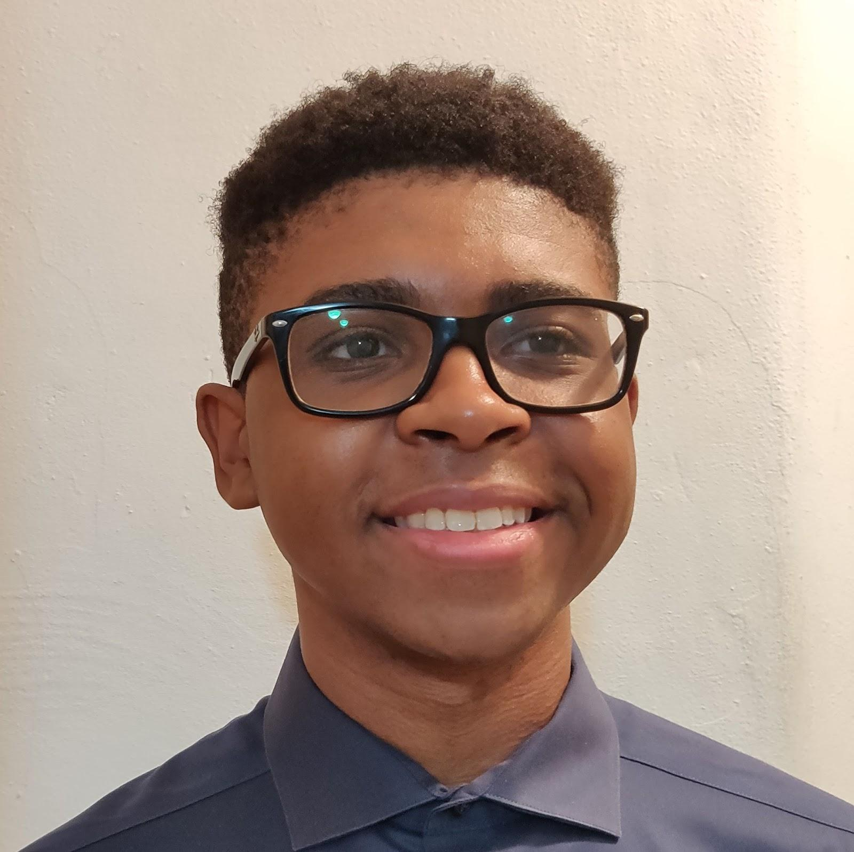
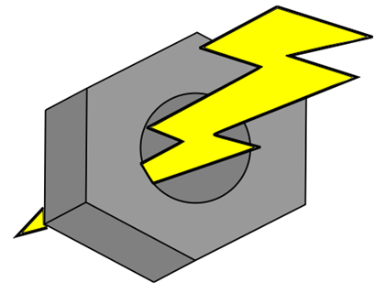


Live Bolt Smart Door Lock
Linda Anyosa (EE)
Mohamed Faizel (CPE)
Andrew O'Reilly (EE)
Joel Shaw (CPE)
Group 22 (F)
Notes:
Joel

Slide 2
Motivation
The main motivation for creating this project was from our individual experience in package theft. An instance that a package has been labeled delivered but, not within the front door or close radius of a home can be bothersome to a customer.
Notes:
Joel

Slide 3
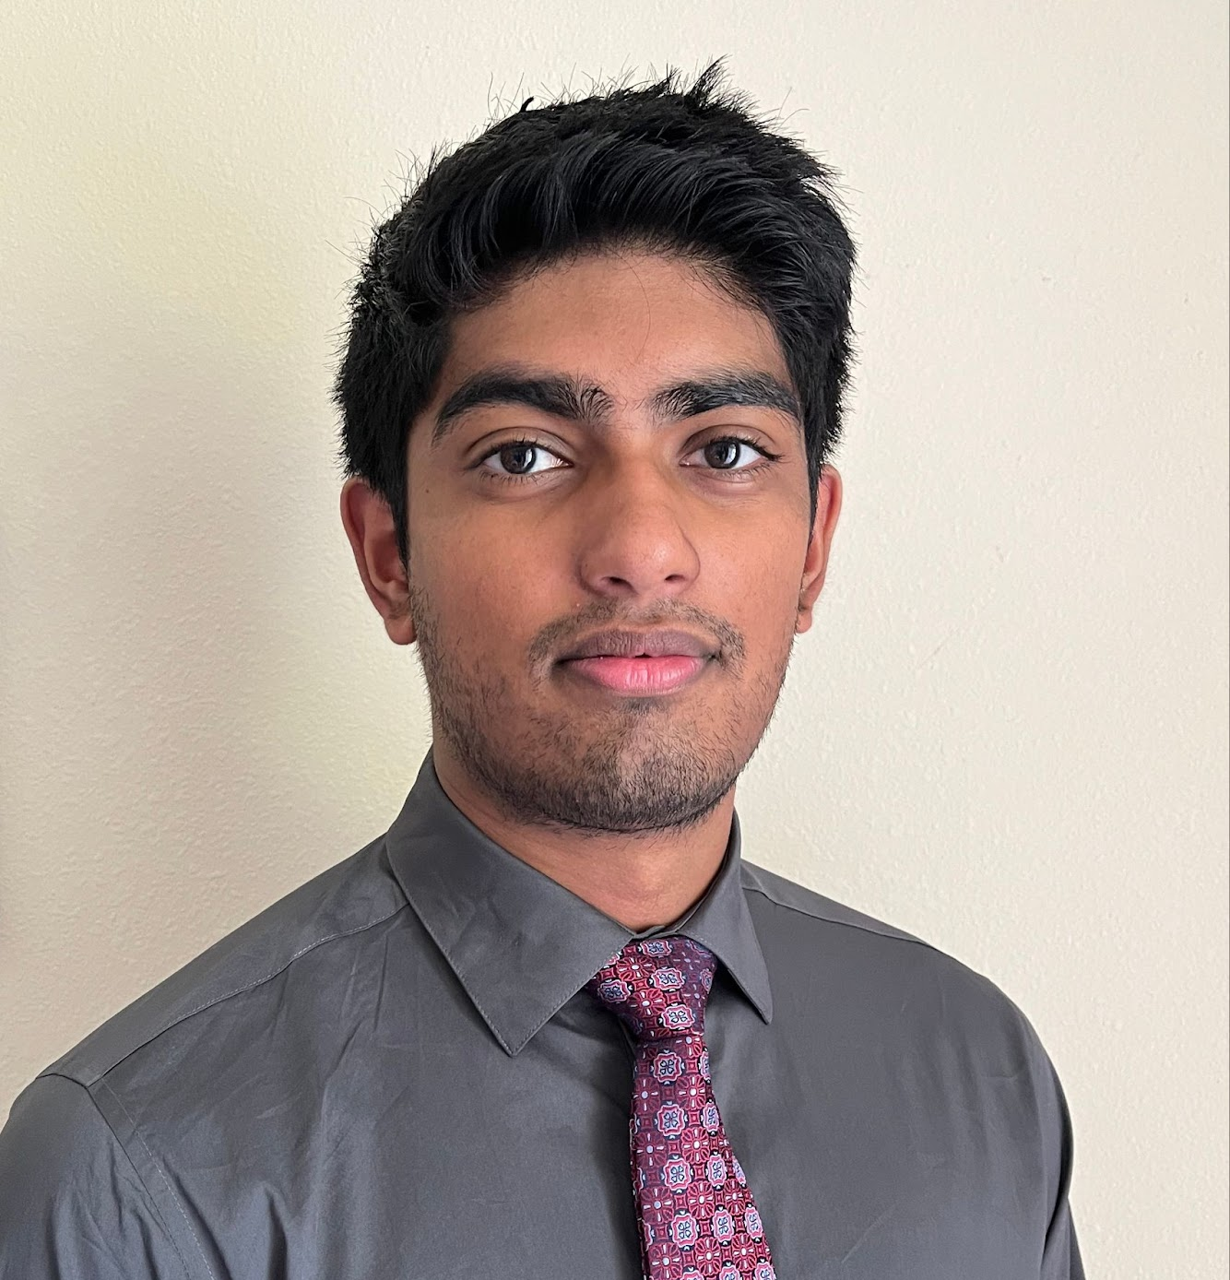
Objectives
Our main objective for the project is to design innovative security and integrated lock system that combines the features of available systems in the market into a package. To have our project stand out, we plan to offer the most features in access control and home monitoring for the best price while ensuring optimal quality, functionality, and aesthetics to our customer's homes and styles.
Notes:
Mohamed

Slide 4
Requirement Specifications Security System
SECTION | REQUIREMENT | SOLUTION | VERIFICATION
Security System (SS)
SS.1 | Notifying motion sense to consume | Controlled through a MCU (IR motion detector) | Integrate sensors to application
SS.2 | Home monitoring | 5 Megapixel, 2592 x 1944 image resolution, 1080p video resolution | Viewable video stream sent from camera
SS.3 | Time stamps unlock attempts | Sensing | Send message to user when attempts are made
SS.4 | Single use PIN numbers for guests/ delivery workers | Application interface for one-use code | Send a text message to guest with one-use code
SS.5 | Alarm system | Integrate LEDs and trigger when multiple attempts are failed in succession | Send message to app when alarm system is triggered
Notes:
Mohamed

Slide 5

Requirement Specifications Access Control
SECTION | REQUIREMENT | SOLUTION | VERIFICATION
Access Control (AC)
AC.1 | Accessibility to consumer with ease | Android/iOS application | Publish to App Store/Google Play Store
AC.2 | Application unlocking system | 4-to-6-digit PIN number, unlock remotely via mobile application, face detection through application, NFC | Notification sent when door is locked/unlocked
AC.3 | Hardware unlocking system | Voice recognition, PIN code access | Door can be opened using external sensors
Notes:
The requirement specifications for the access control elements can be seen here. It is made up of 3 requirements. The first is accessibility to consumer with ease which will be done through the use of a centralized phone app. This will be verified by publishing the app to app stores. The second requirement is the application unlocking system. The app will have a pin code to remotely unlock the system, and will allow for face detection using the smart phones face id features. We also will implemenet NFC using the phone’s NFC tramsitting features. We can verify these features by sending a notification to the user’s phone via the app. The lasy requirement is the hardware unlocking system, which is made up of the physical sensors on the lock like the microphone for phrase recognition and the keypad. These features will be verified when the door can be unlocked using these sensors.

Slide 6
Requirement Specifications Application
SECTION | REQUIREMENT | SOLUTION | VERIFICATION
Application (A)
A.1 | Simple and user-friendly UI/design | Adhere to commonly held design standards for usability | Use a variety of methods to test code, including end-to-end tests
A.2 | Live Bolt must be always-online to mobile application | Use a React API to monitor internet connection | Display message to user if connection is lost
A.3 | Accessibility | Tools like VoiceOver or TalkBack | Integrate TTS in user interface
Notes:
Joel – should be good

Slide 7


Requirement Specifications Design Feature
SECTION | REQUIREMENT | SOLUTION | VERIFICATION
Design (D)
D.1 | Locking door system | High torque servo to turn lock, 10 kg*cm with about 170 degrees range of motion. 3D Printed cover for deadbolt turn knob | Servo is successfully able to turn the knob cover enough to lock/unlock door every time
D.2 | Harness electronic parts in casing | Select a durable printing filament | Research different filaments PLA, ABS, PETG
D.3 | Rechargeable Batteries | Design a reliable battery system to change AA batteries and/or recharge a battery pack | Understand power requirements for electronic parts
Notes:
Linda [Rough draft recording, not done yet]
Our design feature requirement specifications came down to three of our required choices. We wanted to make sure that our project had a locking door system. We're making sure that will end up being the case with the choice of a servo motor to turn a dead bolt knob. Our second requirement was to harness electronics in a casing. We want to make sure our casing (also known as security or lock box) would be durable to withstand weather and be cheap to manufacture. Lastly, we wanted to make sure that our security and lock boxes had rechargeable batteries. To achieve this goal these boxes would need to be accessible to a user and provide ease when changing AA batteries.

Slide 8
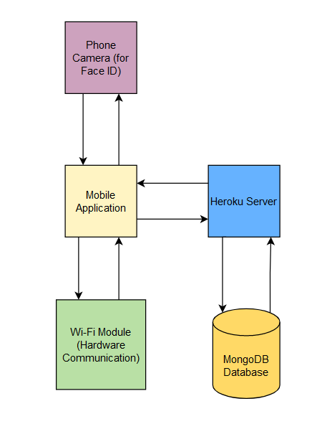
Software Block Diagram
Notes:
Mohamed

Slide 9
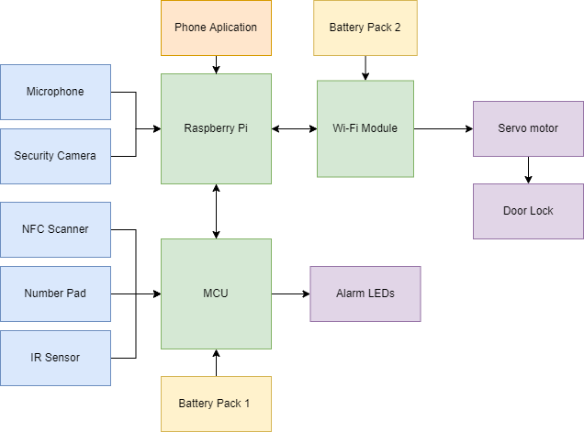

Hardware Block Diagram
Notes:
Here is the Hardware Block Diagram for the Live-Bolt project. The microphone and camera are connected to the raspberry pi while the NFC Scanner, keypad, and IR sensor will be connected to the other MCUs, the Arduino and ESP-8266 chips. The Raspberry Pi will interface with the ESP chips to allow for communication between the outside security module and the indoor locking module that controls the servo motor to turn the door lock. The raspberry pi will also host the phone application and take data from it. Each module will be powered by their own battery packs.

Slide 10
Software Implementation

Slide 11

Frontend Architecture (React Native)
React Native is a cross platform JavaScript UI library currently maintained by Facebook.
We decided to use React Native as the foundation of our frontend due to its portable nature and its superior performance to other UI frameworks such as Flutter and Xamarin.
Additionally, React Native has a variety of developer tools and modules for every aspect of mobile development and testing.
Notes:
Dry run (will probably rerecord)

Slide 12



Backend Architecture (Node.js, Express, and MongoDB)
The Backend Components of the MERN stack consisting of Node and Express JS are previous technologies we have used in previous coursework.
Node is a very popular JavaScript backend runtime environment ensuring widely available documentation. Additionally, both Express and Node are fast frameworks ensuring good response times when communicating across the application.
MongoDB is a fast and scalable database which makes it another ideal choice for our use case within our smart lock.
Notes:
Joel

Slide 13
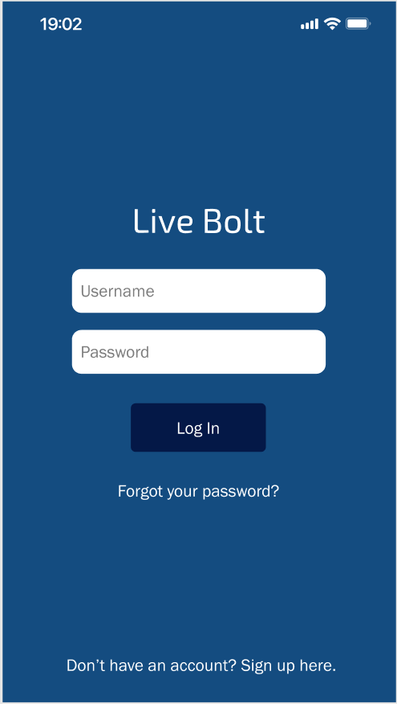
User Authentication
User information is fetched from the remote database to the frontend, including their name, email, phone number, and a unique ID.
Passwords are hashed server-side to prevent leaking of user information and user sessions are authenticated using the JSON Web Token standard.

Slide 14
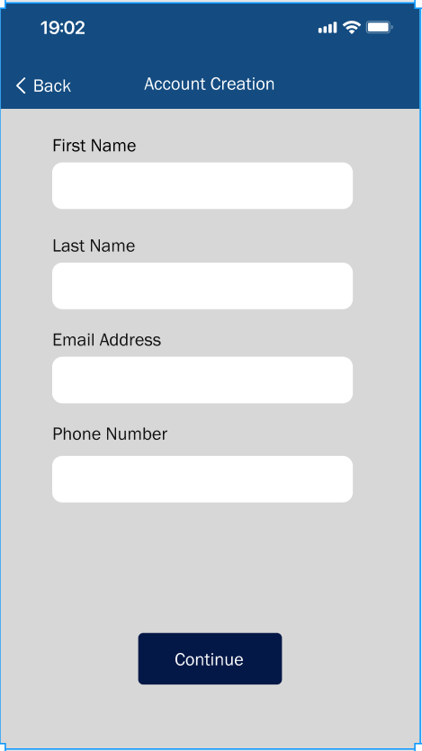
Account Creation/Recovery
User is sent a confirmation email upon account creation and redirected to a page where the user must enter in a 6-digit code to proceed.
In the case of a forgotten password, the user can send an email which contains a link to reset the password.
The app uses the SendGrid API to handle email functionality.

Slide 15
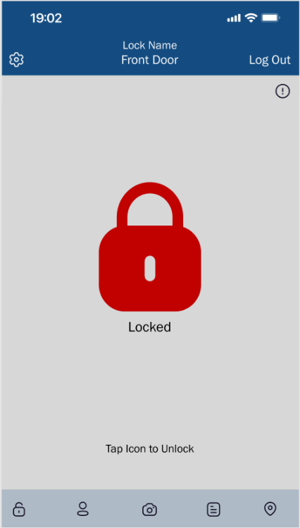
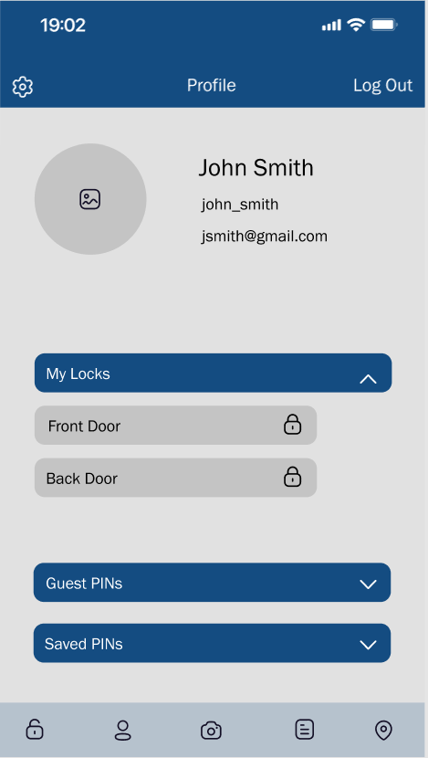
User Experience
Lock
Profile
Live Camera Feed
Activity/History
Location/GPS
Notes:
Joel

Slide 16
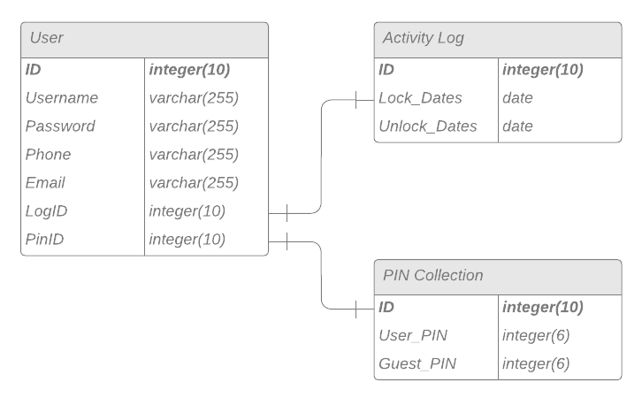
Database
The database mainly consists of three tables: Users, Activity-Logs, and PIN-Collections.
Each user object contains three keys, while the Activity Log and PIN Collection objects contain a single key, along with two arrays.

Slide 17

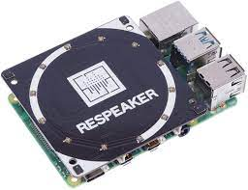
Facial and Phrase Recognition
We will be using native facial recognition technologies on both Android and IOS devices. This includes FaceID on iPhones and Face Authentication on Android.
For Phrase Recognition we will be using the Respeaker Module for the Raspberry Pi 3. We plan on using machine learning to allow for phrase recognition allowing for hands free locking and unlocking the lock.
Notes:
Joel

Slide 18
Selection of Parts
Notes:
Andrew

Slide 19
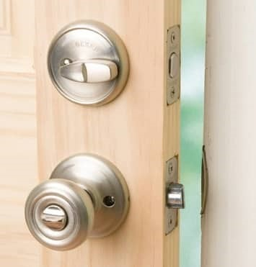
Deadbolt Lock
Seen in most homes
User manually turns thumb knob to strike deadbolt into place
Servo motor will be used to automate this process
Notes:
A traditional dead bolt lock is what is seen in most homes. It operates by having the user manually turn a thumb knob located on the inside of the home. When this knob is turned, the bolt is struck into place, blocking the door from being opened.
To automate this task for the purpose of the Live Bolt system, we will have a servo motor turn the bolt to allow the door to be locked or unlocked remotely without the need for a key or someone on the inside to unlock it.

Slide 20
MCU
A mix of 3 computing modules for various tasks:
Raspberry Pi 3
ESP-12F
ATMega32
Notes:
Andrew

Slide 21
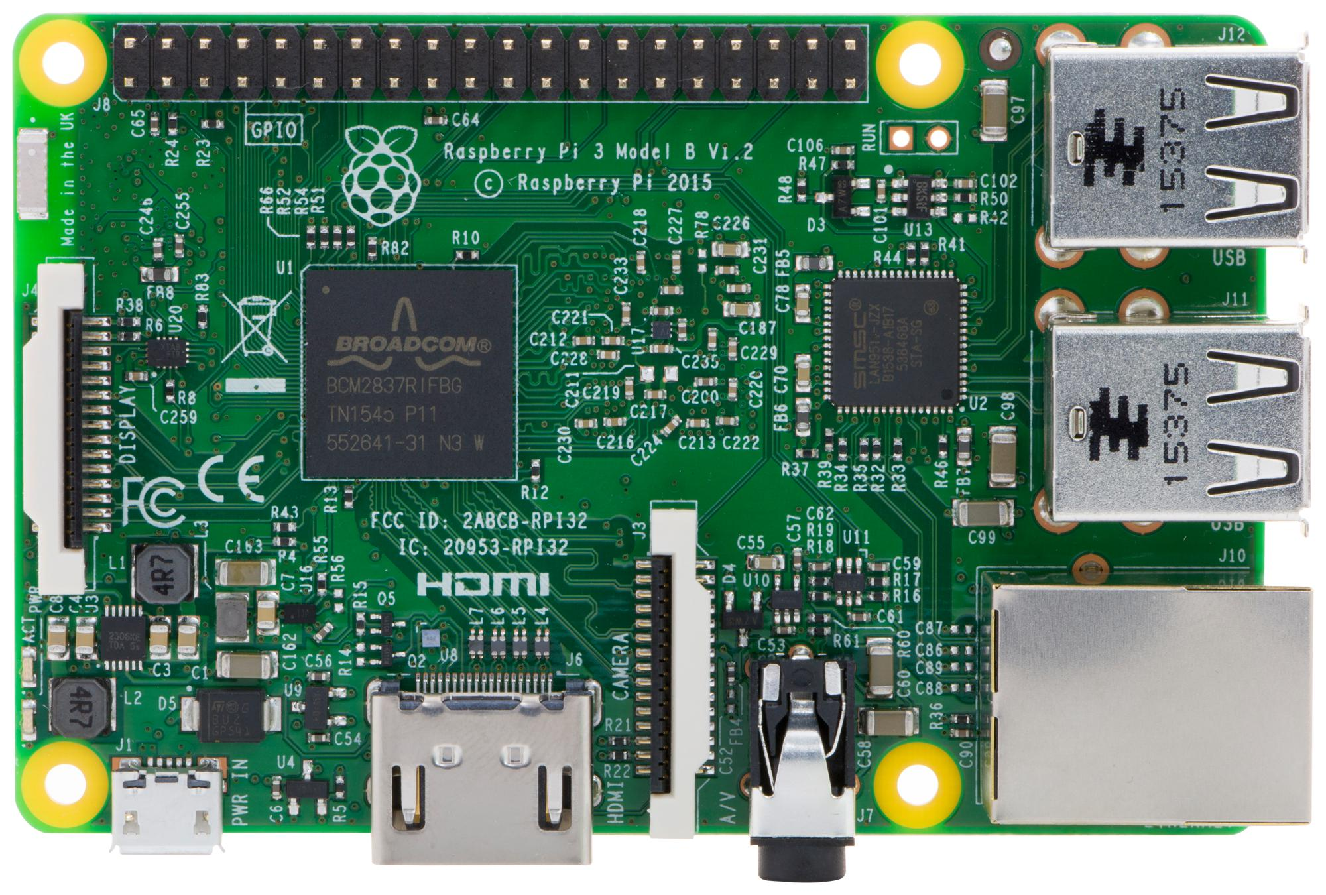
MCU – Raspberry Pi
Connects hardware and software (app)
Will handle live video feed and phrase detection system
Notes:
The raspberry pi will host the phone application. It will also be responsible for interfacing the microphone for phrase detection, and the security camera for a video feed.

Slide 22
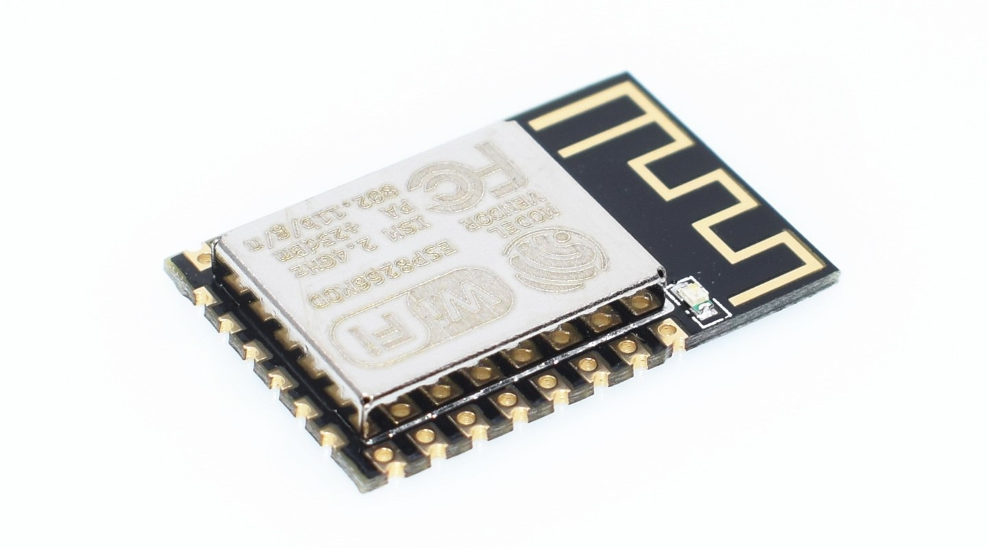
MCU – ESP-12F
Part of the ESP8266 development board
Connects security module (outside) to lock module (inside)
Security module sends signal to lock module to turn servo motor and unlock deadbolt
Notes:
The ESP8266 will process the keypad input.. The output for the ESP8266 will be the security system, which consists of an LED, and the servo motor that will lock and unlock the door. We went with this chip because it has wifi capabilities that wil allow for communication between the indoor and outdoor modules wirelessly.

Slide 23
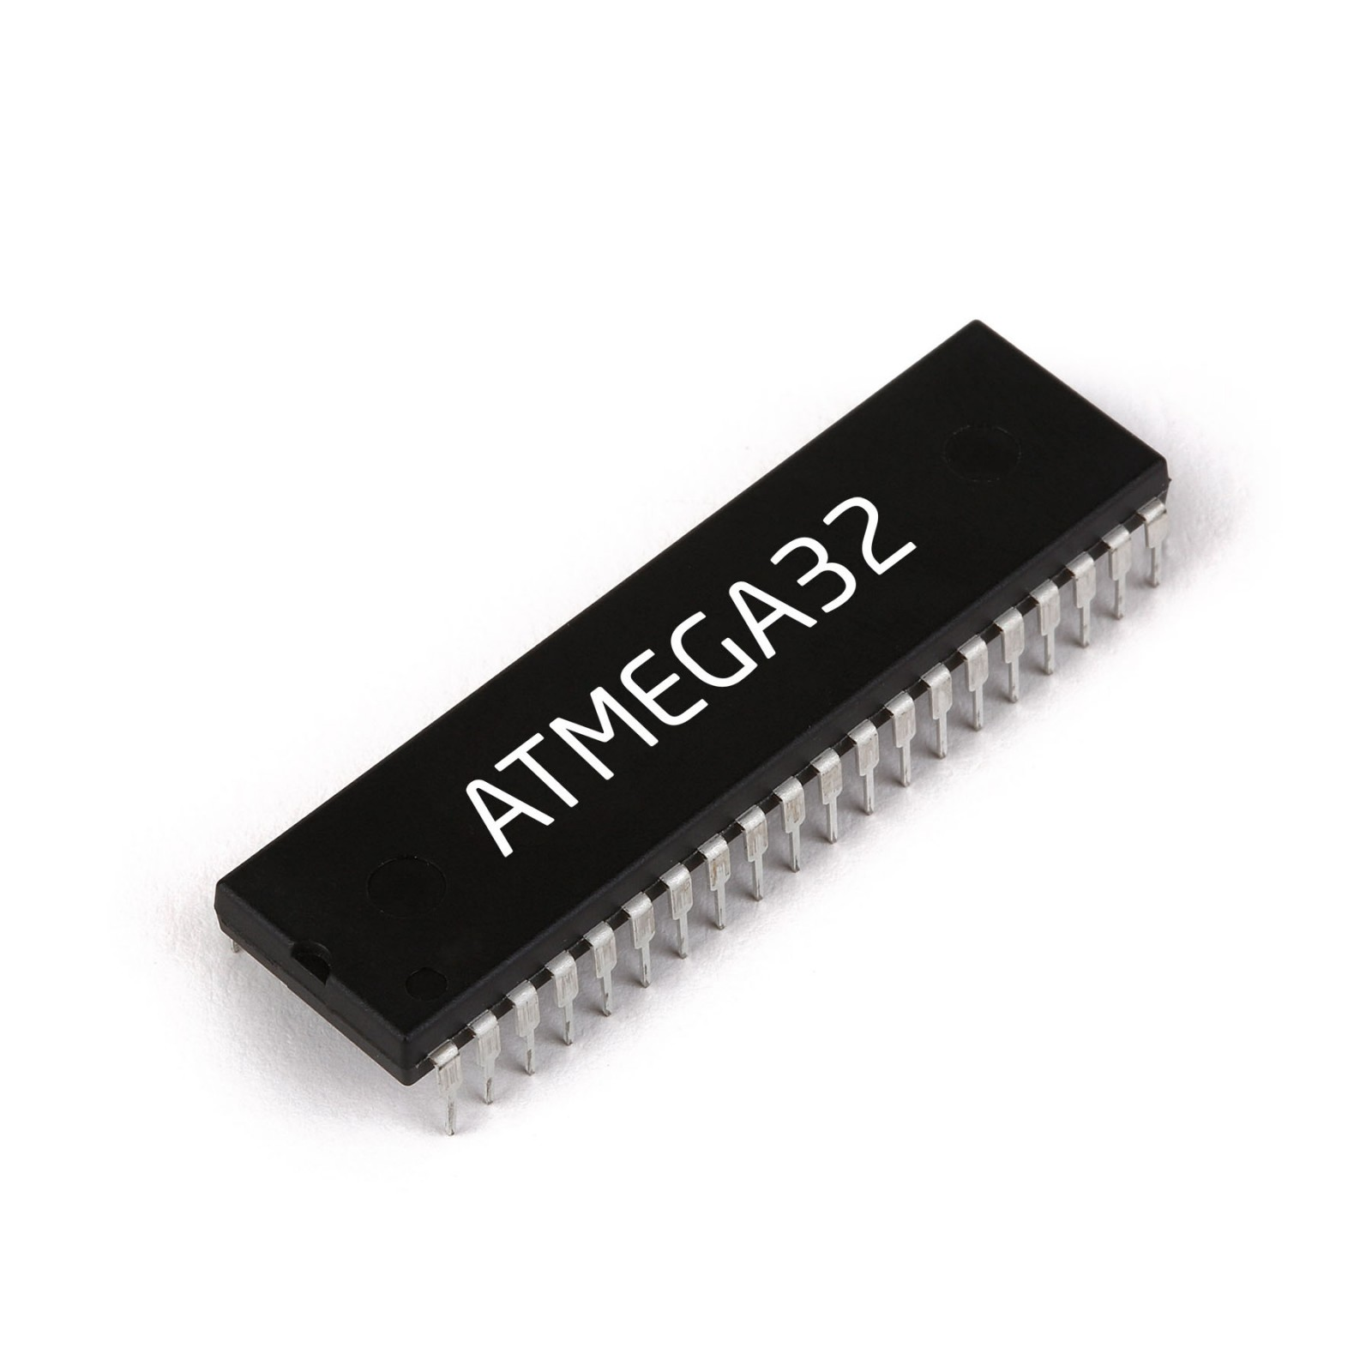
MCU - ATMega32
Part of Arduino Uno development board
Will take in NFC and IR sensor data
Notes:
The Arduino ATMega32 chip is taken from the Arduino Uno development board and will process the NFC scanner input, and the passive infrared sensor. We may try to shift these capabilities fully to the ESP-12F chip if we can get around the limited pin constraint of the ESP-12F.

Slide 24
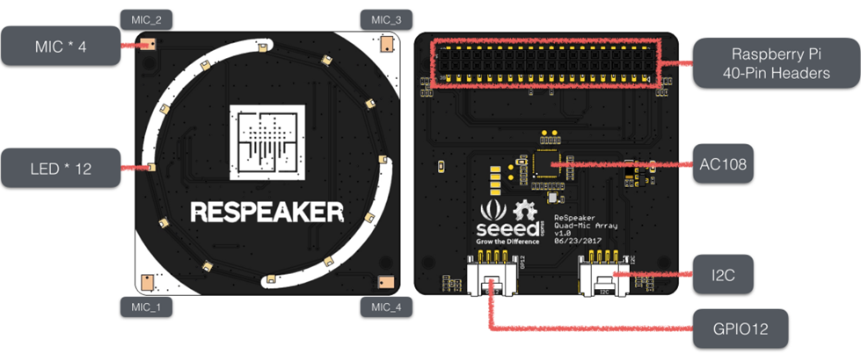
Raspberry Pi Microphone
Used for phrase detection
Connected directly to the Raspberry Pi to act as a microphone array
It includes 4 microphones in an array to ensure accurate phrase detection from different angles
Notes:
The Raspberry Pi microphone will be used for phrase detection to add another layer of security and access control to the lock.
ReSpeaker 4-mic array would provide this action and be connected to the Raspberry Pi.

Slide 25
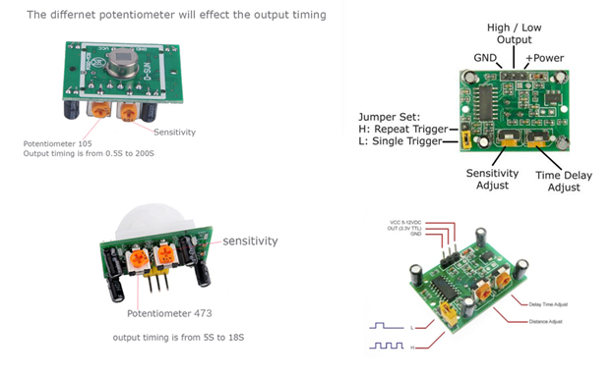
IR Sensor
The IR motion sensor will be part of the Security portion of the design to detect property activity.
The choice of the sensor is known for being energy efficient, high quality, and long service life. There are sensitivity adjustments of 3 – 7 meters and time delay ranging from 3 seconds to 5 minutes.
Notes:
Linda
As previously mentioned, the IR sensor will be integrated to the ATMega32 chip and will be a part of the security portion of the design to detect property activity. This IR sensor is known for being energy efficient, high quality, and provides high service life

Slide 26
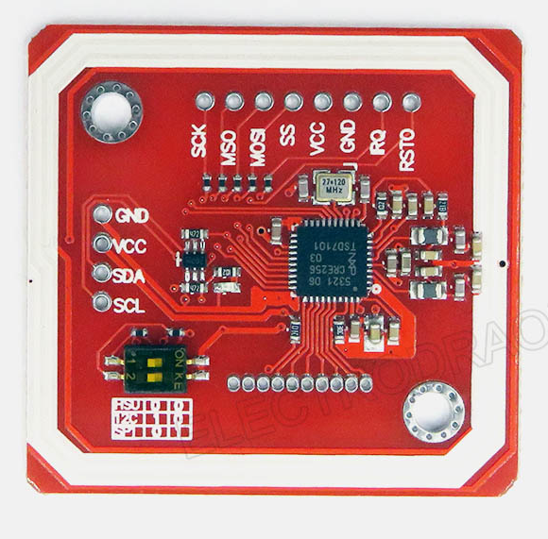
NFC Module
The NFC module would provide access entry for the user using a provided card and potentially through NFC phone application.
This feature would be used in the security box and will connect to the lock box to unlock the door.
Notes:
Card or Android phone, doesn’t work for iPhone
Maybe discuss communication protocol?
Linda

Slide 27
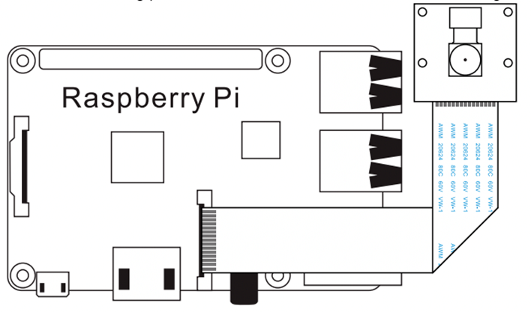
Arducam Camera Module
The Arducam camera module's objective will be to monitor the property and relay a live feed to the application at the consumer's desire.
Implementing the camera would be provided in the security box and connected to the raspberry pi on board.
Notes:
Linda
The selection of the arducam camera module is for home monitoring and can display property activity to the Live Bolt application. This hardware will be connected to the raspberry pi and be harnessed to our security portion of the project.

Slide 28
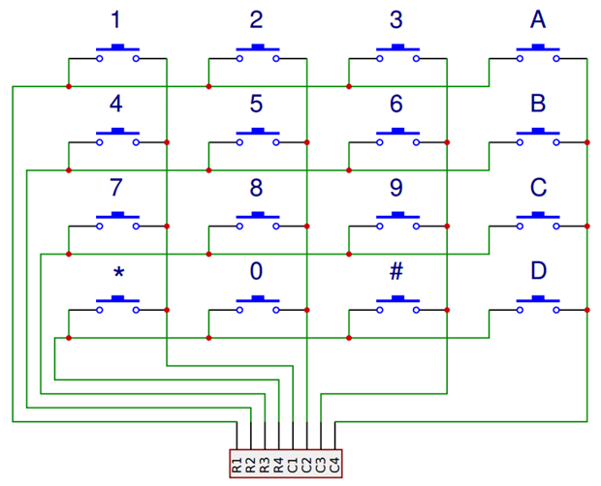
Arduino Keypad
The keypad objective is to be used as a one-time passcode for guests/ delivery service.
The idea is that the one-time passcode can be set through the hardware (front of the security box) and be sent back to the database
Notes:
Linda
The Arduino keypad will be used as a one-time passcode for guests/ delivery services. We plan on mounting the keypad to our security box and will be connected to our MCU. The idea is that the one-time passcode can be set through the hardware (front of the security box) and be sent back to the database.
We are continuing to research to see if it is possible to set the passcode to through the application and configure itself with the user away from their property.

Slide 29
PCB and Schematic
Notes:
Andrew

Slide 30
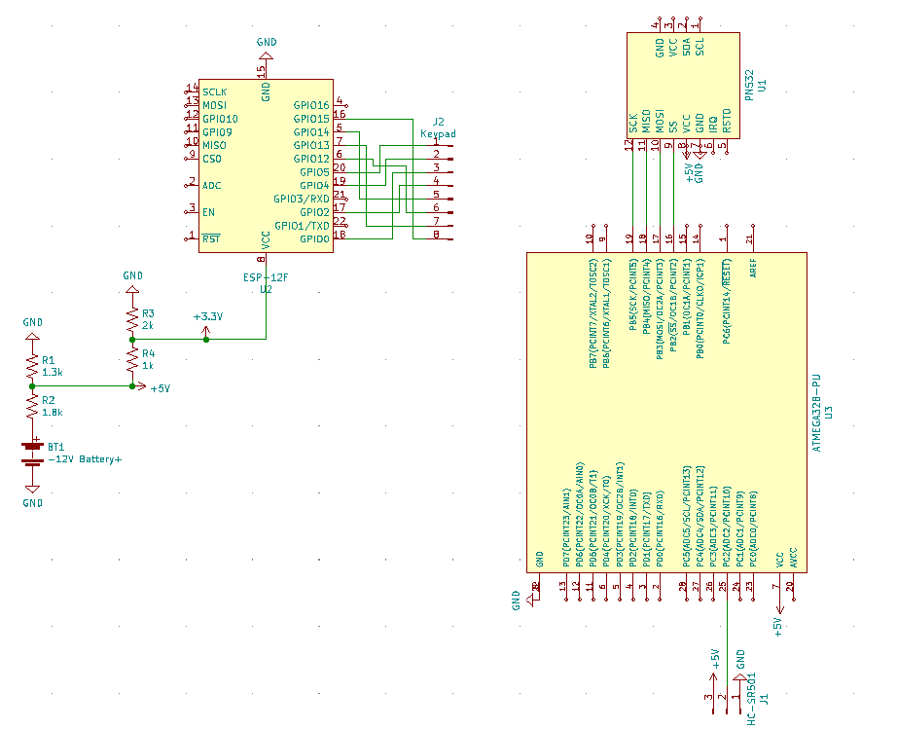
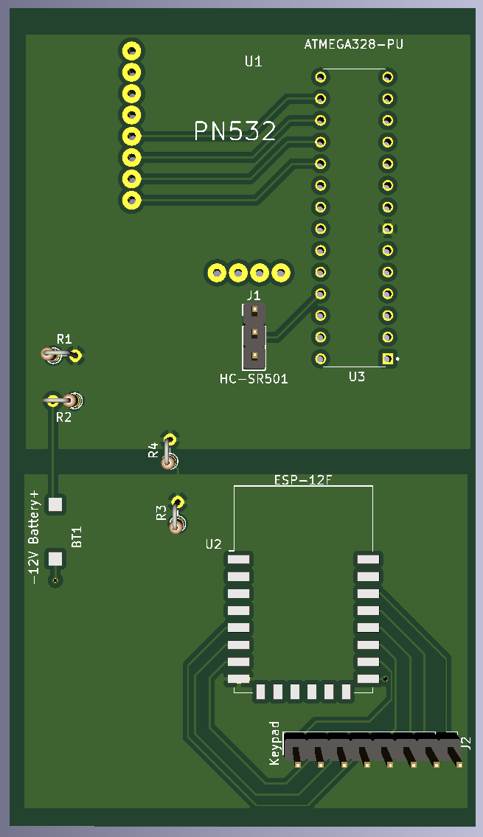
Security Circuit
Notes:
Here is the Security circuit that will be placed in the outdoor module.

Slide 31
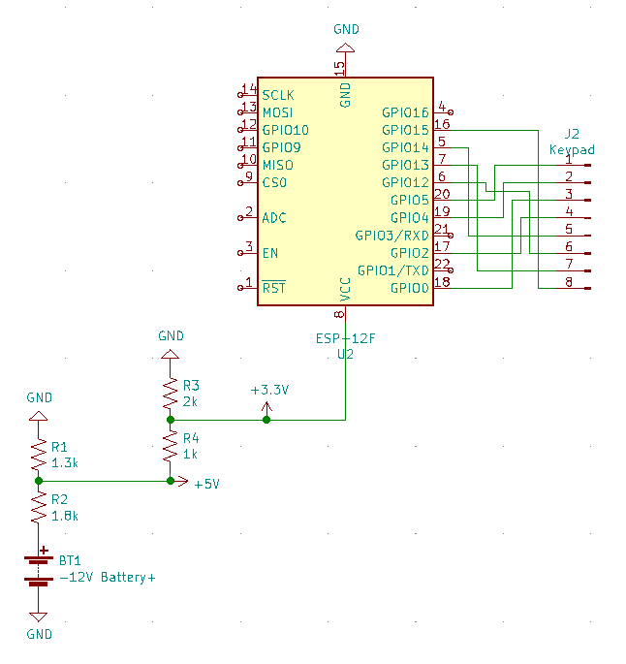
Security Circuit
ESP-12F processor controls keypad
ESP-12F SMT soldered to board
Keypad connected via 8-pin connector
Resistor based voltage dividers drop voltage from 12V to 5V (for ATMega32) and then to 3.3V (for ESP-12F)
Will replace voltage dividers with voltage regulator components to reduce wasted energy dissipated as heat through resistors

Slide 32
Security Circuit
ATMEGA32 controls NFC module and IR sensor
ATMEGA32 and PN532 are through-hole soldered to board
IR sensor connected via 3-pin connector
Powered via 5V from voltage divider
PN532 module controlled via SCK, MISO, MOSI, and SS pins
Notes:
Andrew

Slide 33
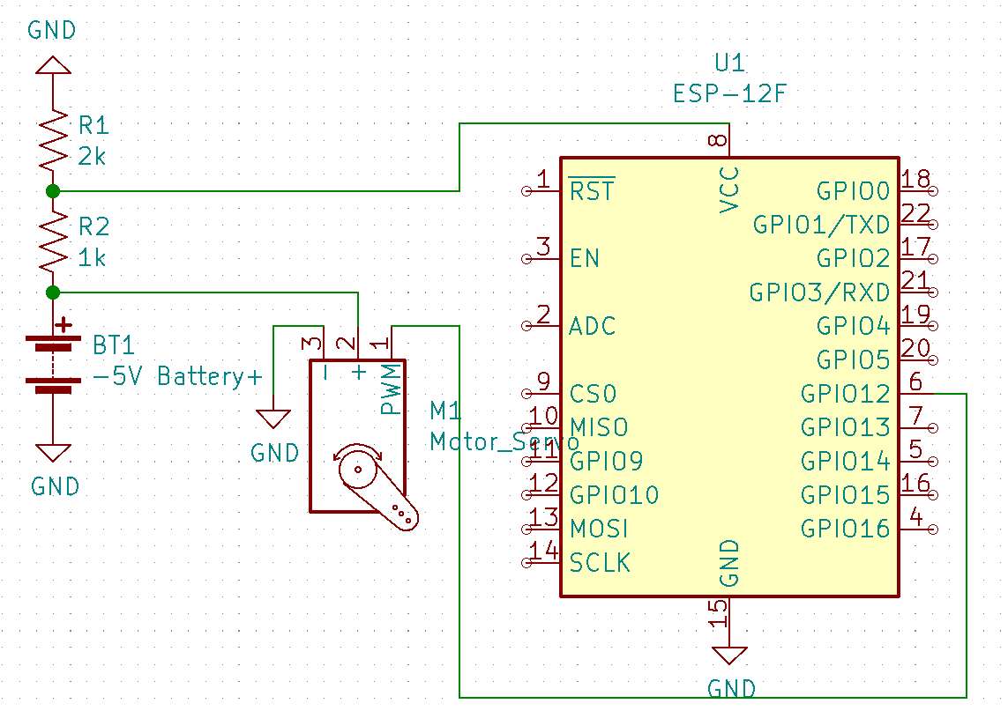
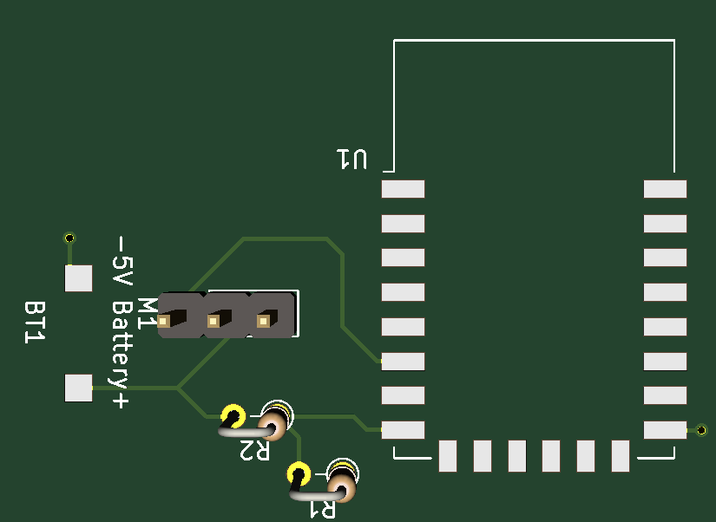
Lock Circuit
5V powers servo motor
Voltage divider drops to 3.3V for ESP-12F
Servo motor has a power pin, ground pin, and signal pin
Signal pin is driven by ESP-12F
Notes:
Andrew

Slide 34
Housing and CAD Models

Slide 35
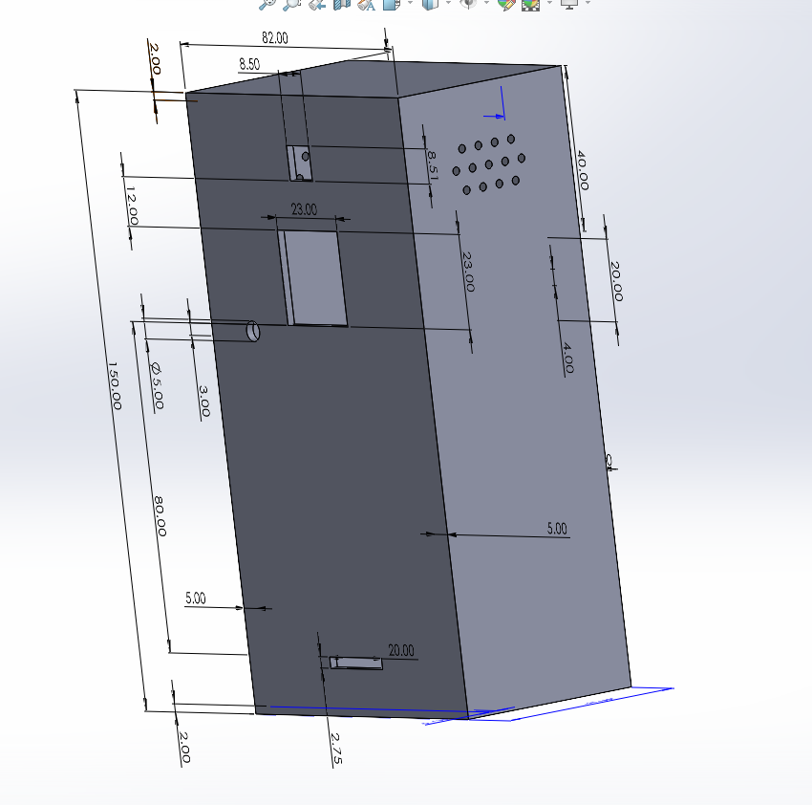
Security Box
Notes:
Linda
To house all the electronics, the team has created a 3D model of boxes to perform that action. The most important electronics that would be highlighted in our security box, excluding the MCUs, will be the Arducam, IR sensor, Arduino keypad, LED light, and raspberry pi microphone.
The features in our security box provides cuts/ openings to have these electronics in place or make their feature usable. Additionally, we've considered an open case box that can be accessible to a user. Mounting is possible with the back cover and screw holes to any users desired security location.

Slide 36
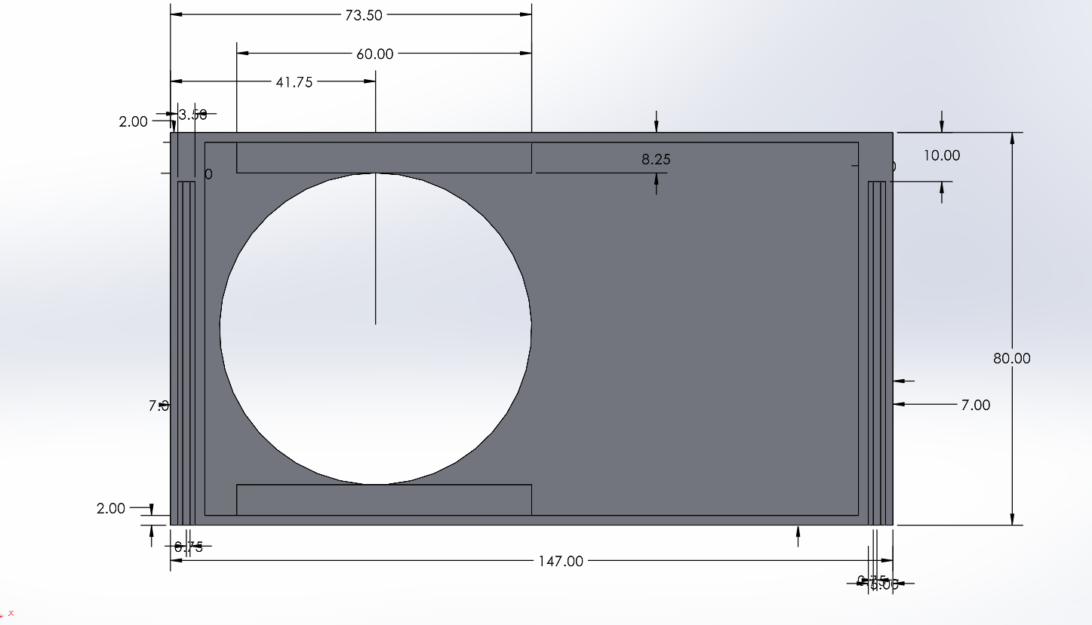
Lock Box
Notes:
Linda
Moving onto the lock box, this box will be installed inside the users home on their deadbolt lock. This will also house electronics such as, the servo motor, ESP chip, and batteries. This box is designed to be opened by the user for battery accessibility.

Slide 37
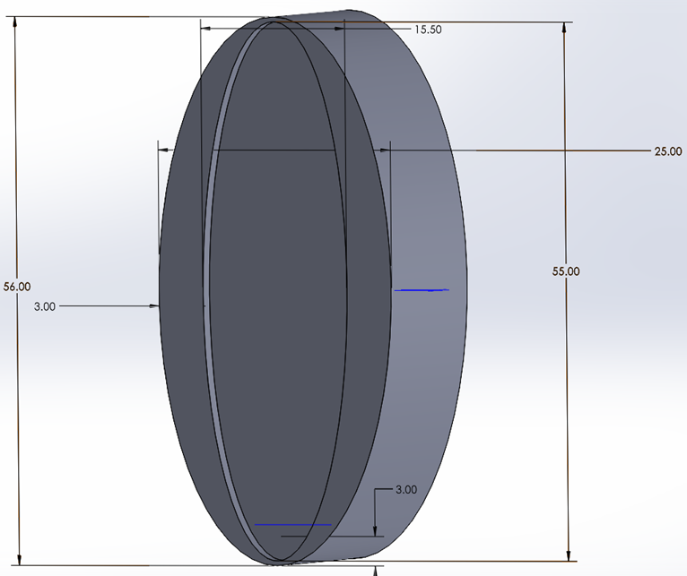
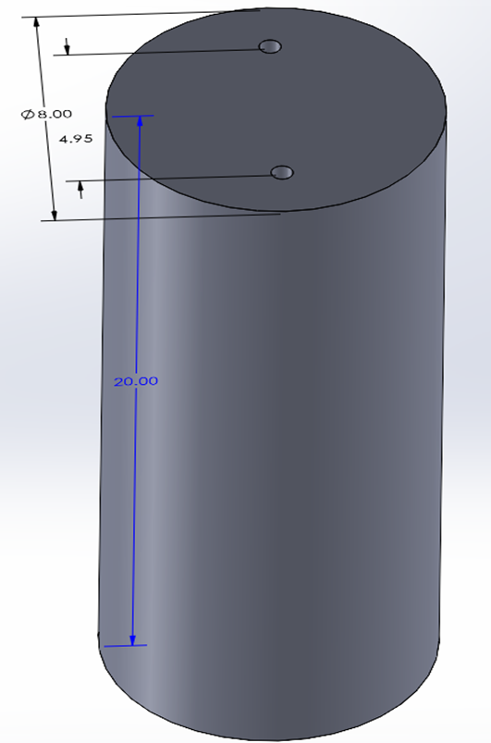
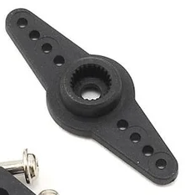
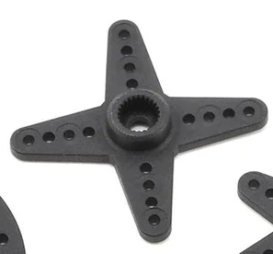
Knob Design
Notes:
Linda
While doing our research on a knob design, we realized that not all dead bolt lock knobs came in one size. Therefore, we decided to create two designs on how we want to turn a knob, using a servo motor, as shown in this slide.
To our left, we have a straight horn being attached to a fixed shape knob case. This knob case size is anticipated to bigger than an average knob in order to execute our access control.
Our second design to our right will be attached to a star shape horn. This design is going to be attached to all ends of the star knob to have four 3D printed pillars turning the knob.

Slide 38
Standards and Design Constraints
Notes:
Andrew

Slide 39
Standards
Standard | Explanation
Wi-Fi (IEEE 802.11) | We will be using a Raspberry Pi in our system which uses the 802.11ac standard or Wi-Fi 5. This standard supports simultaneous connections on both 5 GHz and 2.4 GHz Wi-Fi devices.
NFC (ISO/IEC 14443-4) | Common NFC standards include ISO/IEC 14443, ISO/IEC 18000-3, and those defined by the NFC Forum. These standards deal with identification, proximity, and contact card regulations.
Measurement (SI) | Our design will keep in the international System of Units (SI) and use millimeters (mm) when obtaining dimensions.
Deadbolt (ANSI) | ANSI Grading System was formed by the Builders Hardware Manufacturers Association (BHMA. Grade 2 locks are used on many residential houses.
Battery (IEC 60086) | AA are standardized by the International Electrotechnical Commission (IEC) 60086 code.
PCB (IPC-2221) | The Institute of Printed Circuits maintains the standards for PCB design. We can use some of the standards within IPC-2221, like component mounting and multilayer rules.
Notes:
This is a table of related standards that impacted the design of the Live-Bolt system, such as the IPC-2221 PCB standard and the ANSI Grade 2 standard for the residential deadbolt lock we are designing for.

Slide 40
Constraints
Constraint
Knowledge
Economic
Time
Environmental
Energy
Social
Political
Ethical
Health and Safety
Sustainability
Manufacturability
Notes:
Here are some of the constraints we had to consider when designing this project. The time and economic constraints were some of the more prominent ones as we are on a deadline to finish the project and it is fully self-funded. A full explanation of the constraints is included in our senior design paper.

Slide 41
Administrative Content

Slide 42
Division of Tasks
 | Andrew | Linda | Joel | Mohamed
Frontend |  |  | X | X
Backend |  |  |  | X
API |  |  | X | X
Phrase Detection | X |  | X
PCB | X
MCU Programming | X | X
CAD |  | X | X
Notes:
Mohamed

Slide 43

Budget and Financing
Part Description | Qty Needed | Estimated Price/Unit | Actual Price/Unit | Estimated Total Price | Actual Total Price
Raspberry Pi 3 | 1 | $0 | $35 | $0 | $35
Assorted Wires, LED, and other components | - | $0 | $17 | $0 | $17
Camera | 2 | $15 | $15 | $30 | $15
Keypad | 2 | $0 | $9 | $0 | $9
NFC Reader | 2 | $9 | $9 | $18 | $18
IR Motion Sensor | 2 | $8 | $8 | $16 | $16
Raspberry Pi Microphone Array | 2 | $29 | $29 | $58 | $58
High Torque Servo | 1 | $20 | $20 | $20 | $20
Servo Horns | 1 | $8 | $8 | $8 | $8
Lock Battery Holder | 1 | $8 | $8 | $8 | $8
Security Battery holder | 1 | $7 | $7 | $7 | $7
PLA 3D Printing Filament | 1 | $22 | $22 | $22 | $22
Velcro | 1 | $8 | $8 | $8 | $8
ESP8266 | 1 | $0 | $18 | $0 | $18
PCB Printing | 2 | $2 | $2 | $4 | $4
Total Members | 4 | $34 | $53.75 | $136 | $215

Slide 44
Project Progress
Notes:
Joel

Slide 45
Next Steps
Hardware | Software
Update PCBs and order them | Build out phrase detection model
Reprint CAD models | Finish final touches on the Mobile Application
Interface ESP modules | Test connections between the application, database, and hardware
Finalize assembly and test
Notes:
Joel

